Slide 1
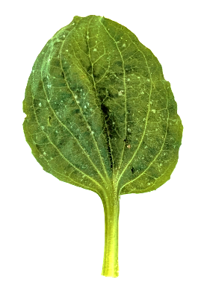

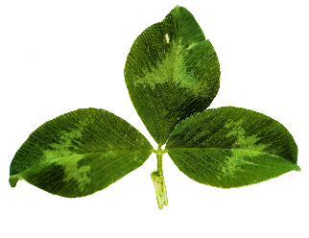
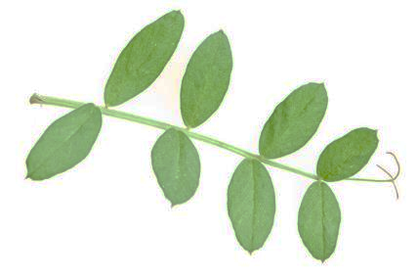
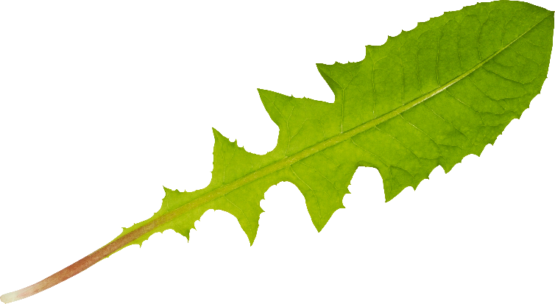
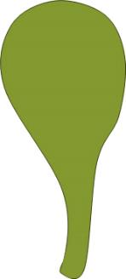


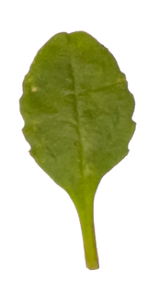
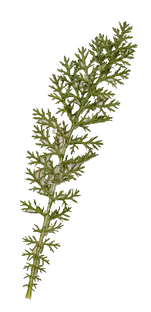
Parts of a leaf
Leaf shapes
Tip
Simple |  |  | Compound
Illustration | Examples |  | Illustration | Examples
Simple leaves have one broad area on a stalk. |  |  | Compound leaves have many broad areas on the stalk. Each broad area is called a leaflet.
Edge
Vein
Stalk
Leaf base
Edge
Tip
Narrow | Oval | Spoon | Fern or feather
Veins
Stalk
Leaf base

Slide 2




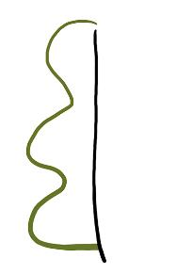
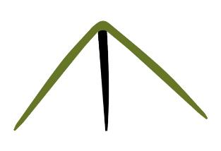
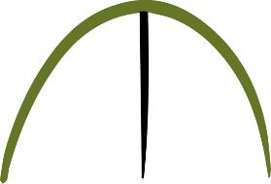
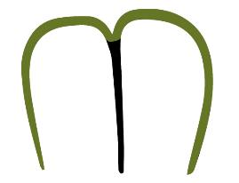
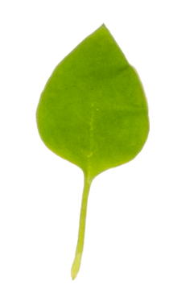
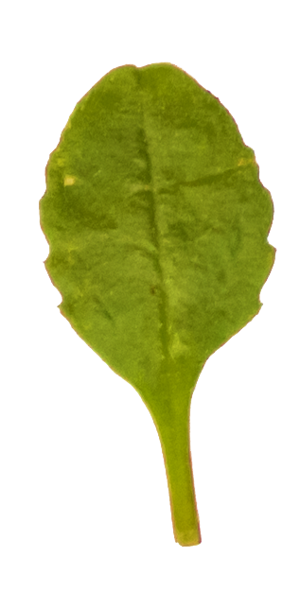
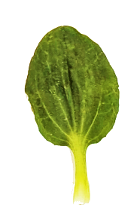
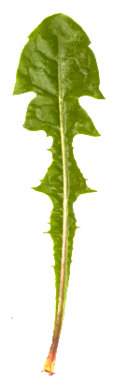


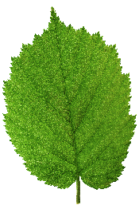
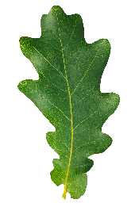
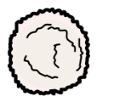
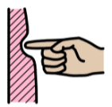


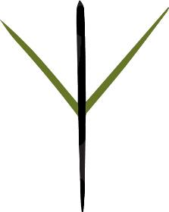
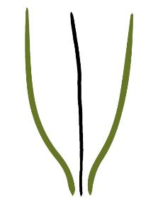
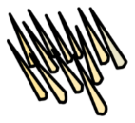

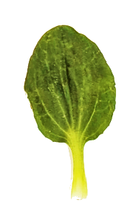



Leaf edges
Leaf tips
Smooth | Toothed | Serrated | Bumpy | Lobed
Pointed | Rounded | Heart-shaped
Leaf textures
Leaf bases
Word | Symbol | Example
Fuzzy |  | sage
Prickly |  | holly, thistles
Word | Symbol | Example
Soft |  | baby spinach
Smooth |  | bay leaves
Tough |  | chard, kale
Round | Heart-shaped | Pointed | Tapered

